Slide 1

Image Recognition with IBM Cloud Visual Recognition Phase 2: Innovation

Slide 2

About us
Image recognition, a branch of computer vision and artificial intelligence, is a set of technologies for detecting and analysing images to automate a certain function. It is a technology that can recognise places, people, objects and a range of other aspects inside a photograph and draw conclusions from them using analysis. Photo or video recognition can be performed with varying degrees of accuracy depending on the type of information or concept sought. A model or algorithm can recognise a single component just as quickly as it can categorise an image.

Slide 3

What is Image Recognition?
Image recognition is the process of identifying and detecting objects or features in a digital image or video. It is a key technology in various fields such as computer vision, artificial intelligence, and machine learning.

Slide 4
IBM Cloud Visual Recognition:
IBM Cloud Visual Recognition is a powerful tool that utilizes deep learning algorithms to analyze and classify images. It can identify objects, scenes, and faces, as well as detect text and explicit content.

Slide 5
Enhancing Image Recognition:
IBM Cloud Visual Recognition enhances image recognition by providing pre-trained models and custom training capabilities. It enables developers to create applications with advanced image analysis and understanding capabilities.

Slide 6
Challenges in Image Recognition:
Image recognition faces challenges such as variations in lighting conditions, complex backgrounds, and occlusions. These challenges can affect the accuracy and reliability of the recognition results.

Slide 7
Image recognition is one of the problems being solved within the computer vision field:
Computer vision is a broader set of practices that solve such issues as:
Image classification with localization – identifying an object in the image and showing where it’s located by drawing a bounding box around it.
Object detection – assigning label classes to multiple objects in the image and showing the location of each of them with bounding boxes, a variation of image classification with localization tasks for numerous objects.
Object (semantic) segmentation – identifying specific pixels that belong to each object in an image.
Instance segmentation – harder than semantic segmentation because it’s about differentiating multiple objects (instances) belonging to the same class (breeds of dogs).

Slide 8
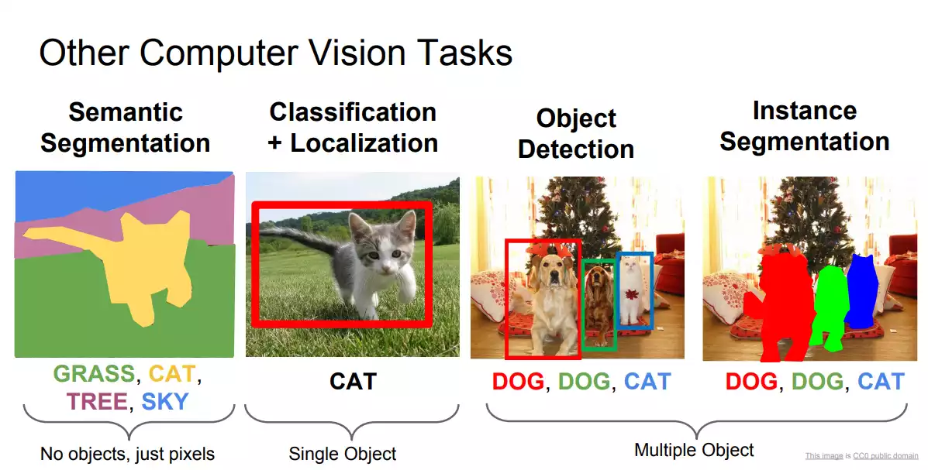

Slide 9
Conclusion
The Innovation phase is a crucial step in turning our design thinking concept into a practical solution for Cloud Application Development. By following these structured steps, we aim to address the environmental challenges effectively and make a positive impact on sustainability efforts. IBM Cloud Visual Recognition empowers businesses and developers to build intelligent applications that can accurately analyze and understand images.

Slide 10

Thank you

